Slide 1
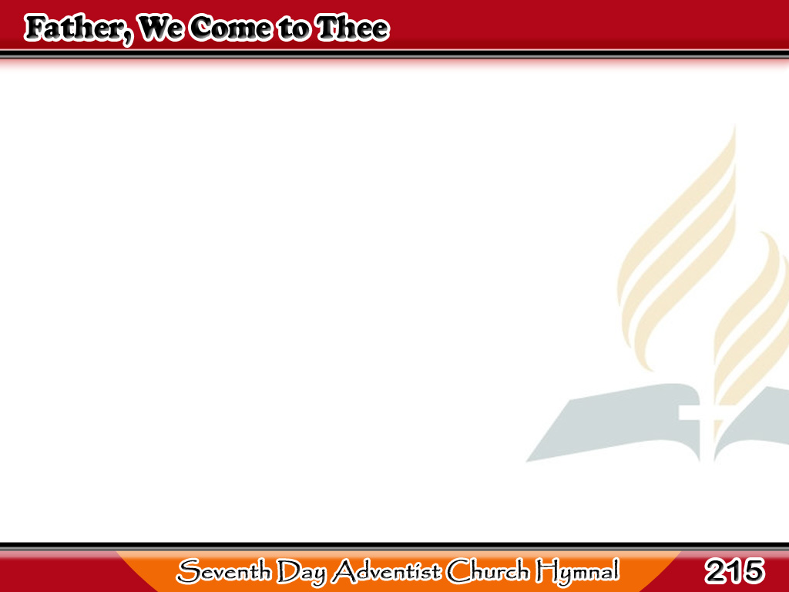
Kami’y Lumalapit
Father, we come to Thee,
No other help have we;
Thou wilt our refuge be,
On Thee we call.
1/3

Slide 2
Kami’y Lumalapit
Earth is but dark and drear
Without Thy presence near;
Be Thou our comfort here,
Father of all.
1/3

Slide 3
Kami’y Lumalapit
-Refrain-
Father, we come to Thee,
Turn not away;
Helpless we come to Thee,
Hear while we pray.
1/3

Slide 4
Kami’y Lumalapit
Save from our many foes,
Save our earthly woes;
Be Thou our soul’s repose
In time of need,
2/3

Slide 5
Kami’y Lumalapit
Doubting are we, and weak;
To us sweet courage speak;
Thy mighty arm we seek
For strength indeed.
2/3

Slide 6
Kami’y Lumalapit
-Refrain-
Father, we come to Thee,
Turn not away;
Helpless we come to Thee,
Hear while we pray.
2/3

Slide 7
Kami’y Lumalapit
Give us Thy grace divine,
Seal us forever Thine;
Our wayward feet incline
From sin to flee.
3/3

Slide 8
Kami’y Lumalapit
Oh, guide us, we implore,
Till weary life is o’er,
And on a brighter shore
We dwell with Thee.
3/3

Slide 9
Kami’y Lumalapit
-Refrain-
Father, we come to Thee,
Turn not away;
Helpless we come to Thee,
Hear while we pray.
3/3

